Slide 1
The ancient Egyptians
By
Oak Class

Slide 2
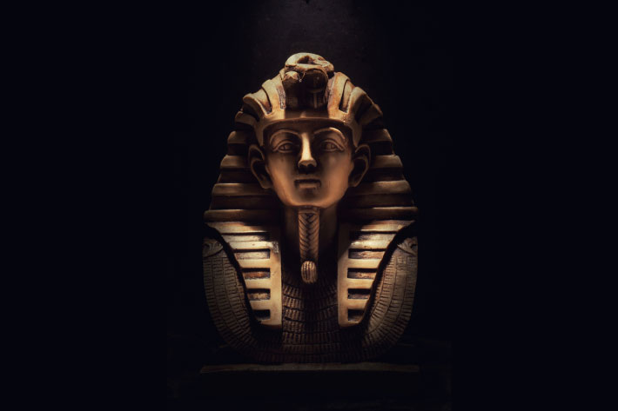
Pharaohs were the king or queen of the country. The Pharaoh was in charge and made all the decisions and they would be the ones that would decide whether there were rules or not, since they were the most powerful of all in ancient Egypt times. They used to think that pharaohs could communicate to the dead and were seen as a living god! Some people around the world would send their daughters to marry the king/pharaoh. Pharaohs almost always had a beard(or at least a fake one!)

Slide 3
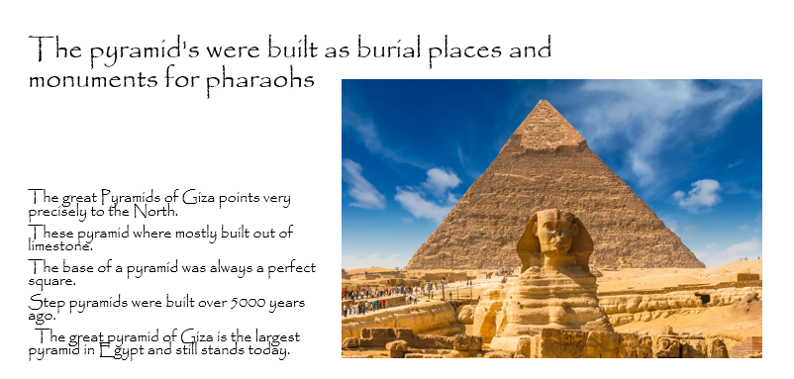

Slide 4
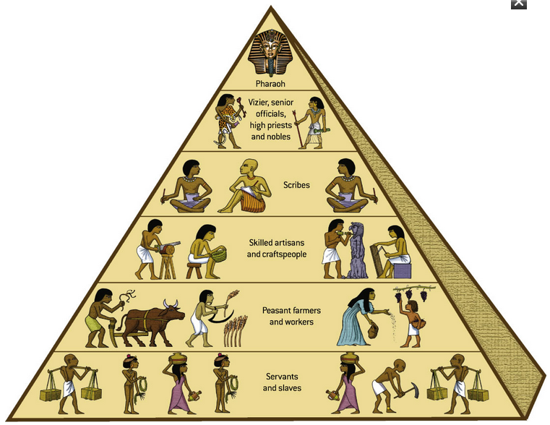
The social Pyramid
Most important
Least important

Slide 5
Farming
  CROPS
  Fun facts
  They grew wheat, barley, vegetables, figs, melons, pomegranates, flax and grain.
  Papyrus grows on the banks of the river in the Black Land. The Black Land is a big part in farming as it is the perfect soil for growing crops.
  Flax was woven into clothes.
  Papyrus is a plant that grows by the Nile and can be made into one of the first forms of paper.
  Wheat was one of the most taxed things in ancient Egypt.

Slide 6
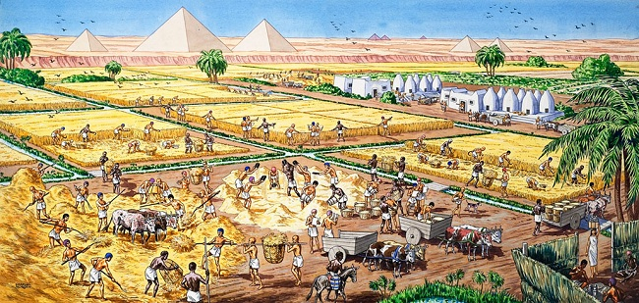
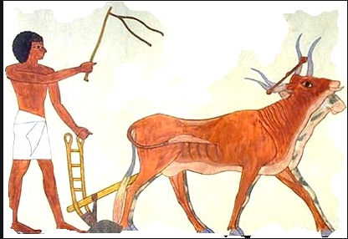
Egyptian farmers used oxen and horses to trample seed and wheat into the ground.
Animals were very important to the Egyptian farmers because they did loads of work around the farm they had jobs such as pulling the plough, eating unwanted grain and wheat and providing the Egyptian people with food and drink. They kept animals such as cattle, goats, duck, cows, pigs and geese. A shadooff is a machine used for carrying water from the river Nile to farming land. they used winnowing scoops, hoes ,rakes, flint bladed sickles and ploughs. The farmers main seasons were the flooding seasons and the harvesting season.

Slide 7
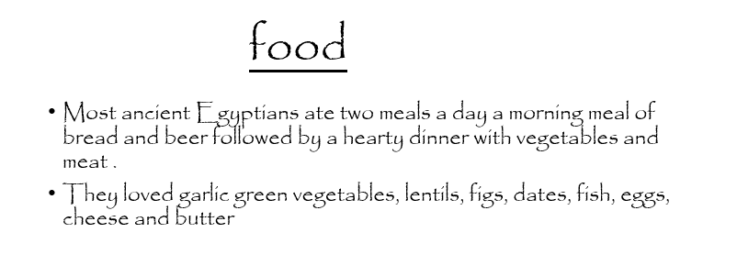

Slide 8
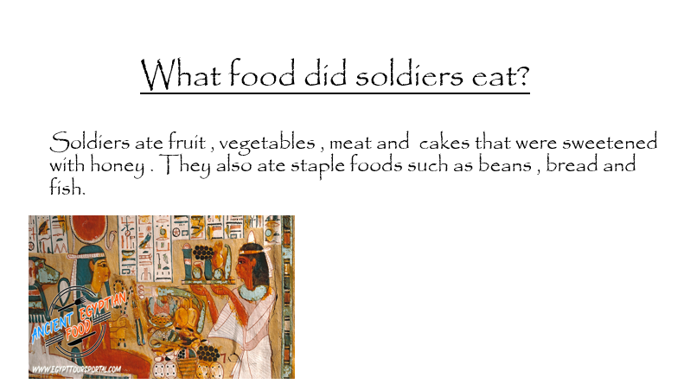

Slide 9
Clothing
Egyptians wore, skirts, cloaks, dresses and kilts made out of white linen and sewn together with cord.
Pharaohs wore leopard skins around their shoulders and lion tails attached to their belt
All the Egyptians wore jewellery from farmers and slaves to rich families and pharaohs. All their jewellery was made from natural products like precious stones, metals, glass beads, clay, stones, shells, animal teeth and bones. jewellery represents the wealth of
a person and wearing more jewellery meant that the gods were pleased with you and were blessing you.

Slide 10
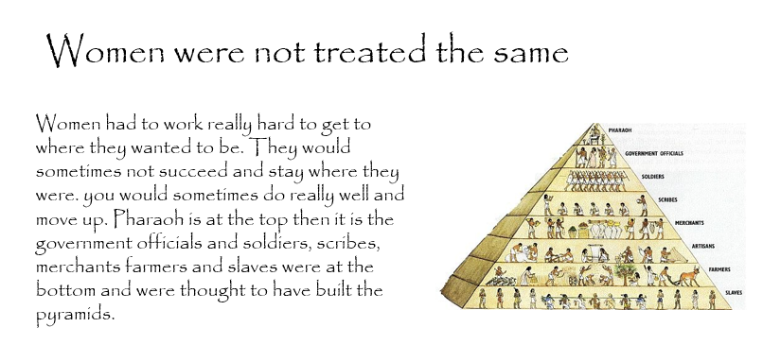

Slide 11
HOUSES
The houses were made of natural stuff like mud bricks by putting them in a furnace.
Wealthy people had stone houses
They normally had a courtyard and did cooking in the courtyard
They only had 3 rooms
They painted them light colours so the sun reflects off it
They had flat rooves so they could sleep on the roof when it was hot
They had 4 foot doors high because of the sand storms
They also had iron bars to keep out the animals and thefts
The rich had 30 rooms in their houses
They were small houses

Slide 12
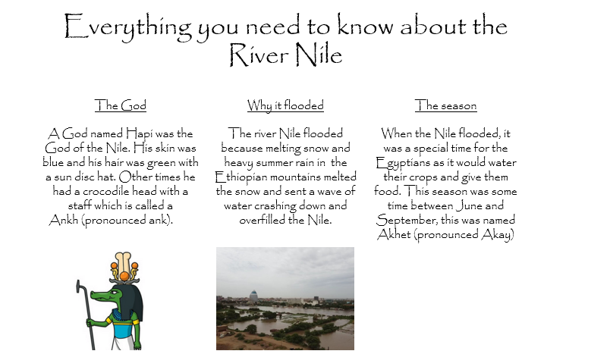

Slide 13
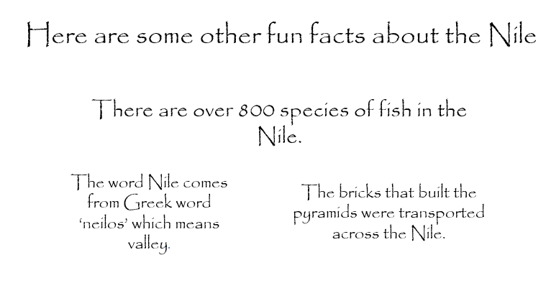

Slide 14
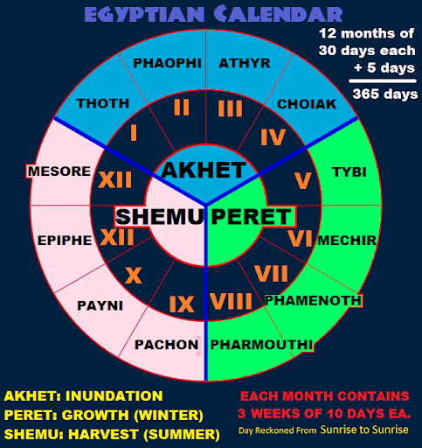

Slide 15
Pyramids
Pyramids were built for the Pharaoh’s.
They were built for Pharaohs to be buried in, in tombs!
Pyramids took 20-30 years to complete.
In circa 2630 BCE the first pyramid was built.
They built pyramids for over 1000 years!
To start with, Egyptologists believed that slaves built the pyramids, but through years of study and research, they now believe that skilled craftsman built them.

