Slide 1
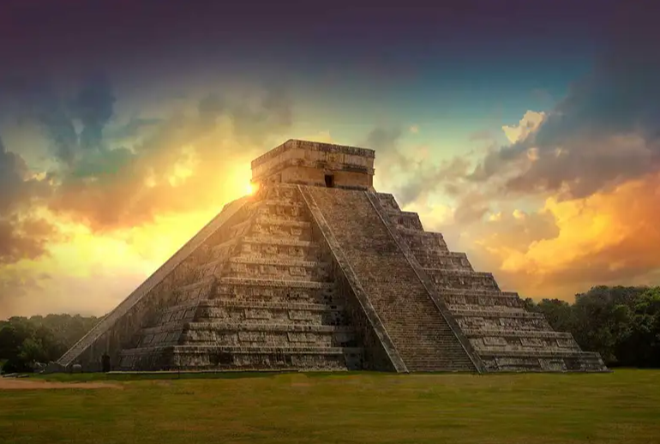
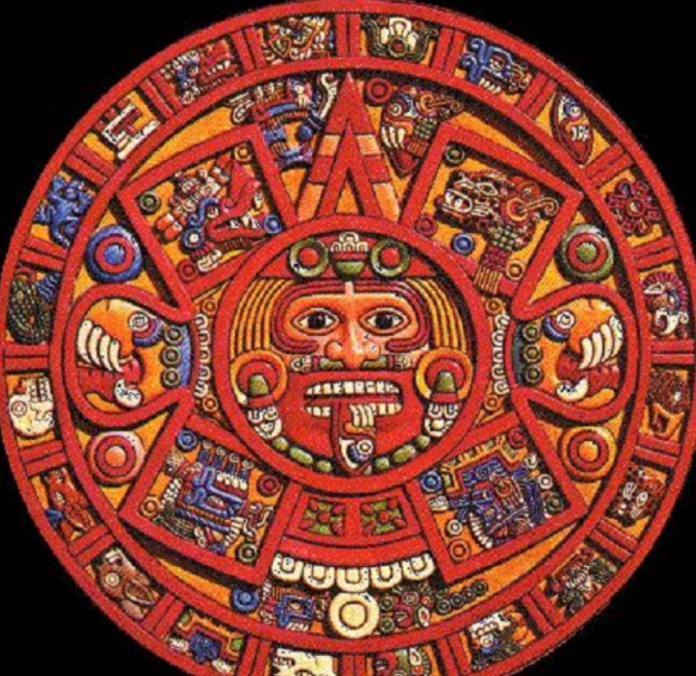
The ancient maya
Researched by Maple Class

Slide 2
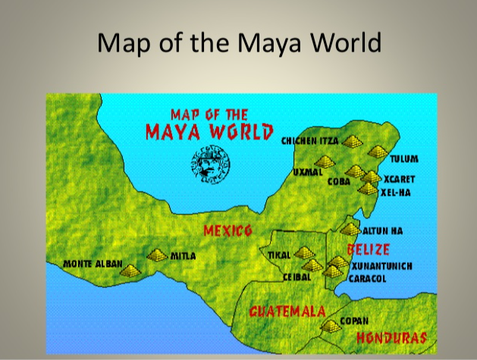
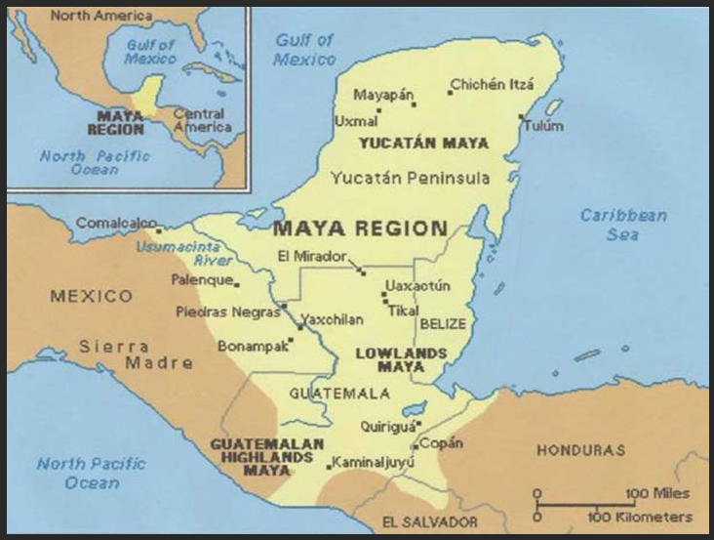
The Ancient Maya lived in Mesoamerica (what is now central America).
They lived in:
Parts of Mexico
Parts of Honduras
Belize
Guatemala
Parts of El Salvador

Slide 3
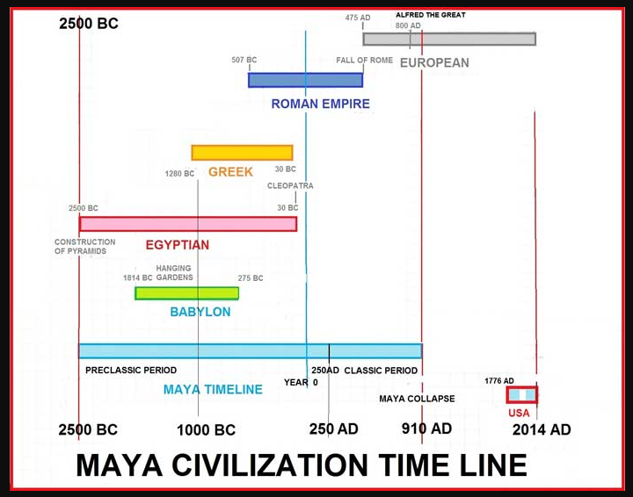
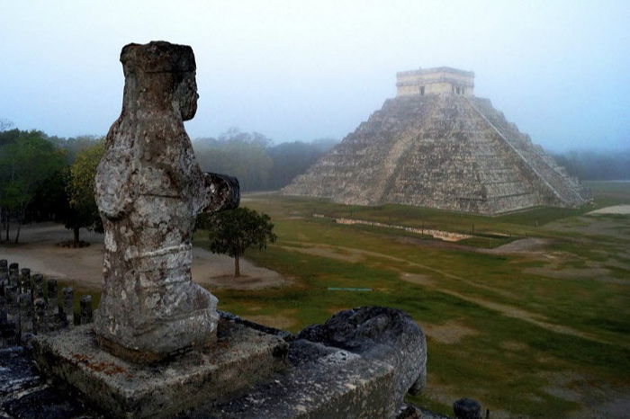
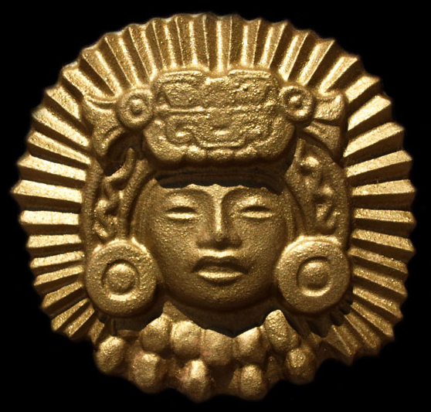
The Maya civilisation lasted longer than the Greek and the Egyptian civilisations.

Slide 4
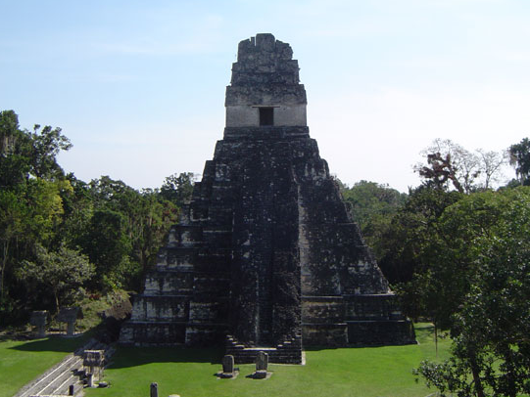

Maya architecture
Chichen Itza
Chichen Itza is a large Mayan city famous for large pyramid and temples built by the Maya civilization. El Castillo is the largest pyramid at Chichen Itza, and dedicated Kukulkan the plumed serpent.
Pyramids
Unlike Egyptian pyramids Maya pyramids are stepped just like this picture here.
These pyramids can be found in ancient ruins of Tikal.
Maya architecture is best characterized by the soaring pyramid temples and ornate palaces which were built in all Maya centres across Mesoamerica from El Tajin in the north to Copan in the south.

Slide 5
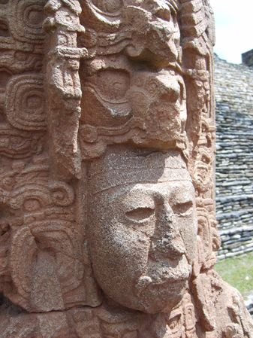
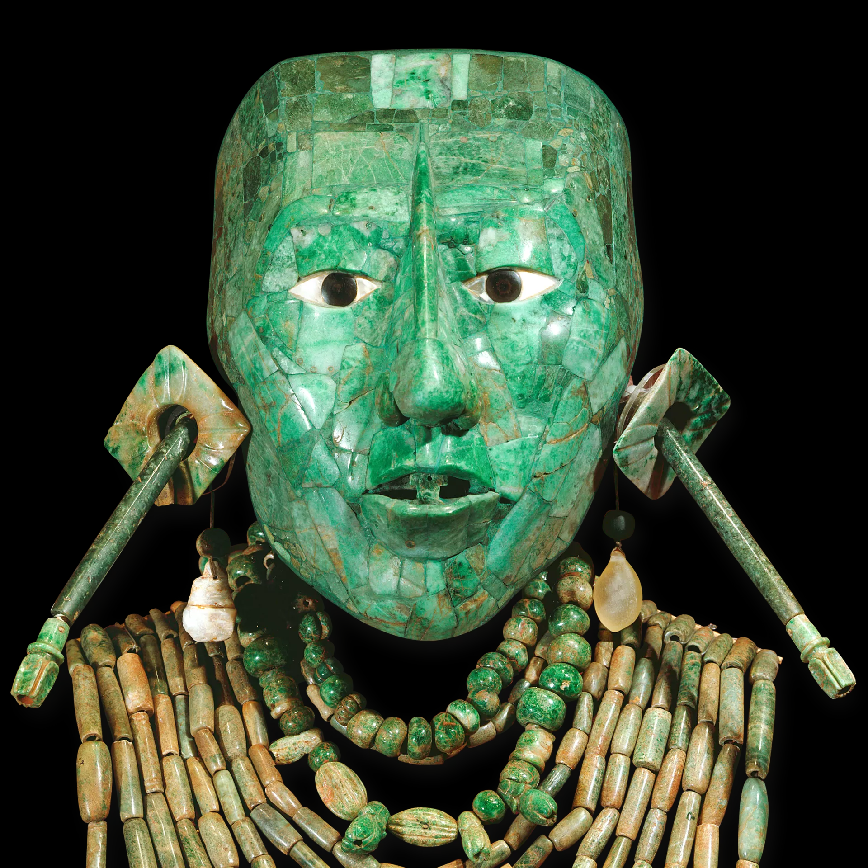

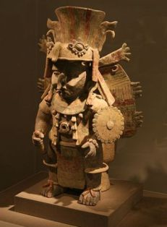
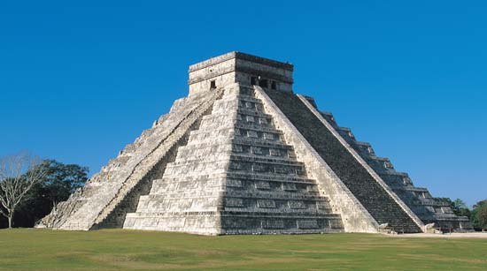
Maya art by Sonny and Faye
The Maya are most famous for their work in stone to create pyramids, temples and palaces
The Maya civilization existed for over 1500 years. During that time the Maya created many works of art. The art of the Maya was heavily influenced by their religion. The subject for much of their artwork was the Maya kings who wanted to make sure they were remembered throughout history.
A couple of types of Maya art are : carving, ceramics, painting and sculpture
The Maya produced some of the most amazing art of there time using wood jade emeralds and more.
Interesting Facts about Maya Art, Maya artists sometimes signed their work. Other arts included the performing arts of dance and music. The Maya had a variety of musical instruments including wind instruments, drums, and rattles. Some of the more complex instruments were reserved for the elite. The Maya used stucco plaster to create large masks and portraits of both the gods and the kings. The kings would often commission a work of art to commemorate events in their lives. The city of Palenque is often considered the artistic capital of the Maya civilization. It wasn't a big or powerful city, but some of the finest Maya art has been found within this city.

Slide 6

Maya Astronomy and Stargazing
The Maya looked to the heavens for guidance. The Maya were so good at reading the stars that they made their cities as a map of the stars. They traced the sun, stars and planets but traced Venus the most. As well as tracing the planets, stars and sun, the Maya also recorded all the actions of those things. The Mayans believed that all actions of the gods could be read in the sky and some wars would even be delayed until the gods were in place . They also believed that the Earth was the centre of all things and that the Earth was fixed in place and unmoveable. Venus was the most important planet to the Maya and battles and wars where arranged to coincide with the movements of Venus. The Maya determined that Venus` years where 584 days- close to the actual 583.92.The stars were less important to the Maya, as they were more practical, then the: sun, moon, Venus and other planets. The moon was nearly as important to the Maya as the sun. Venus, Mars, Saturn and Jupiter were the planets that the Maya were aware of. No one knew more about Venus than the Mayans. Because the Maya discovered the number 0, they could make very precise calendars. The Maya had a calendar for religious reasons that was 260 days; the Maya also had a calendar for farming that was 365 days long and was split up into 18 months of 20 days and 5 unlucky days were everyone stayed indoors!

Slide 7
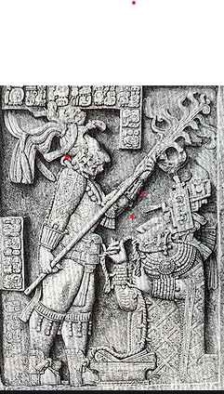

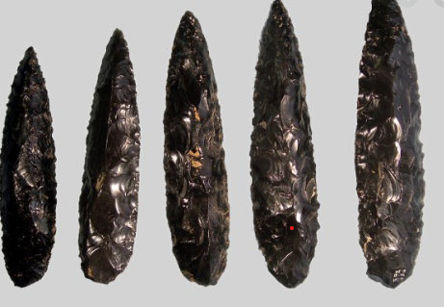
MAYA BLOODLETTING!
Researched by Lily and Darcey T
Is bloodletting still used today?
Bloodletting is still indicated for a few indications such as polycythaemia, haemochromatosis, and porphyria cutanea tarda, while leeches are still used in plastic surgery, replantation and other reconstructive surgery, and very rarely for other specific indications.
What is Bloodletting?
Bloodletting is……….
When a member of Maya society [occasionally royalty] pierces themselves with the spinal cord of a Sting Ray on the lips, ears or tongue. But it was not always Royals some locals did Bloodletting at festivals to show their appreciation for the gods.
How is bloodletting performed?
Practitioners typically nicked veins or arteries in the forearm or neck, sometimes using a special tool featuring a fixed blade and known as a fleam. In 1163 a church edict prohibited monks and priests, who often stood in as doctors, from performing bloodletting, stating that the church “abhorred” the procedure
2000-year old obsidian knifes from Maya times

Slide 8
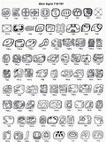
Maya Alphabet
The Maya alphabet was very complicated as it had over 1100 glyphs. Only 3 of them were for numbers a dot , a line and a shell. They wrote on bark , stone and pottery. They Were made nearly 500 years before their most successful point in time. These symbols were known as hieroglyphs ( for short glyphs ). Maya script, also known as Maya glyphs, was the writing system of the Maya of Mesoamerica and is the only Mesoamerican writing system that has been substantially deciphered. The earliest writing found which are Maya found in the 3rd century. Maya writing was in use throughout Mesoamerica until the in the Spanish conquest of the Maya 16th and 17th centuries.

Slide 9
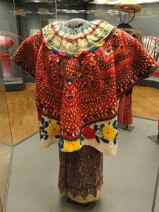
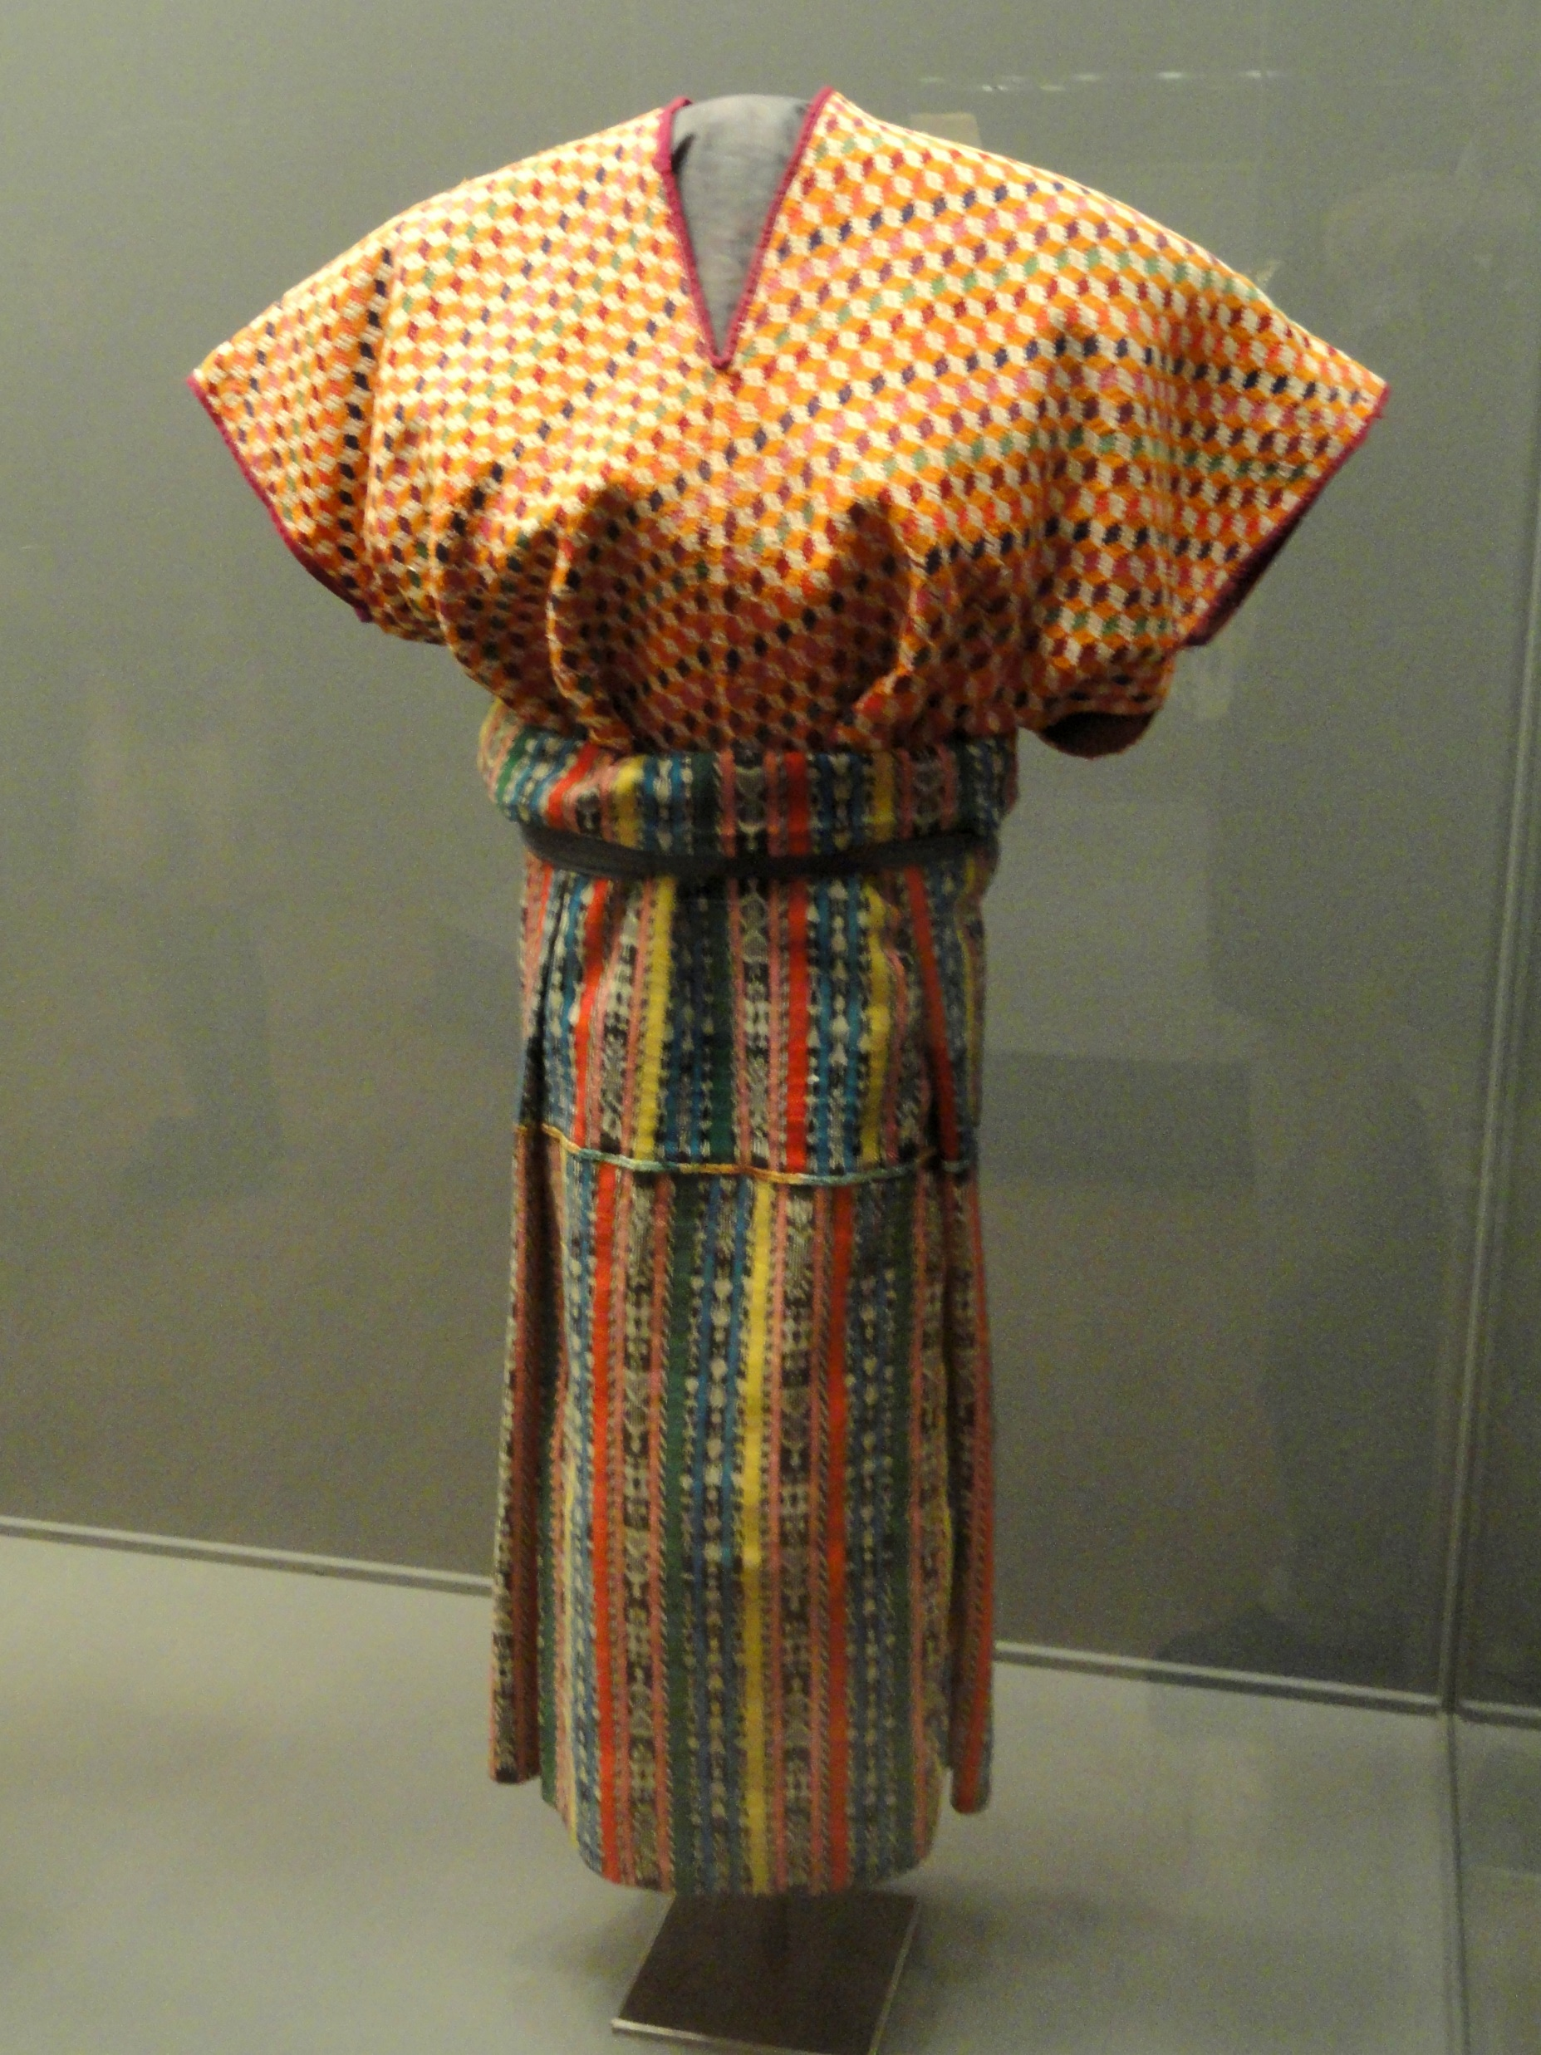
Maya citizens wore fancy necklaces and sparkly jewellery and most clothing depended on there Statas and most men and women and men had tattoos after they were married
_{Maya clothing}
Men were long clothing such as a kilt or skirt they carry a weaved bag many men wore colourful cloths like turbans in winter and a poncho/cloak in summer
Women wore a rap of fabric around them to keep them warm
By Katie and Ava

Slide 10
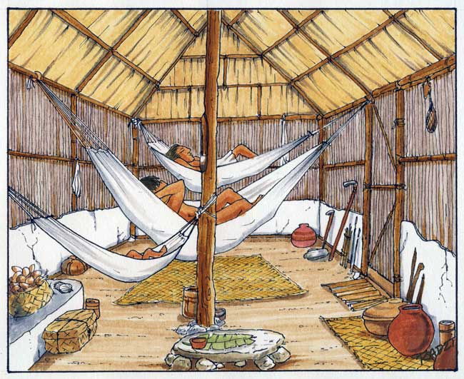
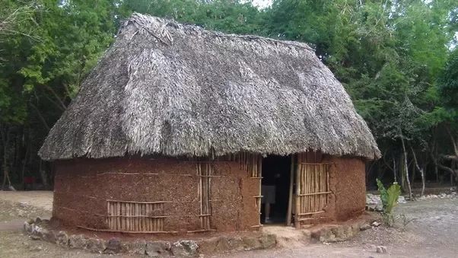
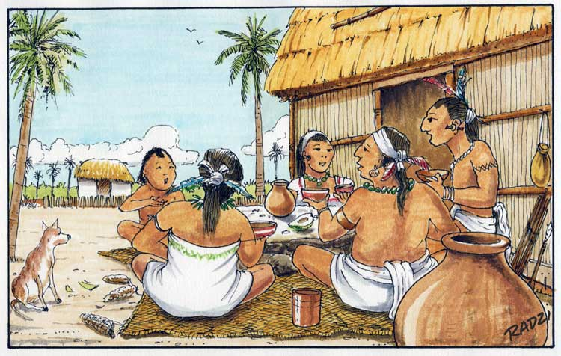
Maya Family
Maya Boys
Most boys spent the day with other boys learning to paint and carve hieroglyphs. At school learnt math & astronomy. Most rich families expected them to take over the running of the city.
Maya houses were arranged so that large family groups could live together. Most Maya families lived a very simple life. New year was an important time for everyone.
Maya children
Girls had an arranged marrage. When a baby Is born they take them to a priest. Moms taught daughter how to do things.
Maya adults were in charge of the house like they are now, well only the men where. Maya had a game called Pok-a-tok
The men’s duties included farming and hunting ,while the woman weaved and cooked .The children helped there mothers with chores and only went t school if they came from a Noble family.
Research by Layla and Khadija

Slide 11
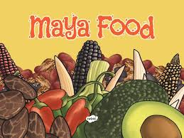
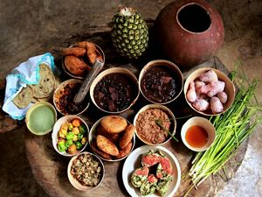
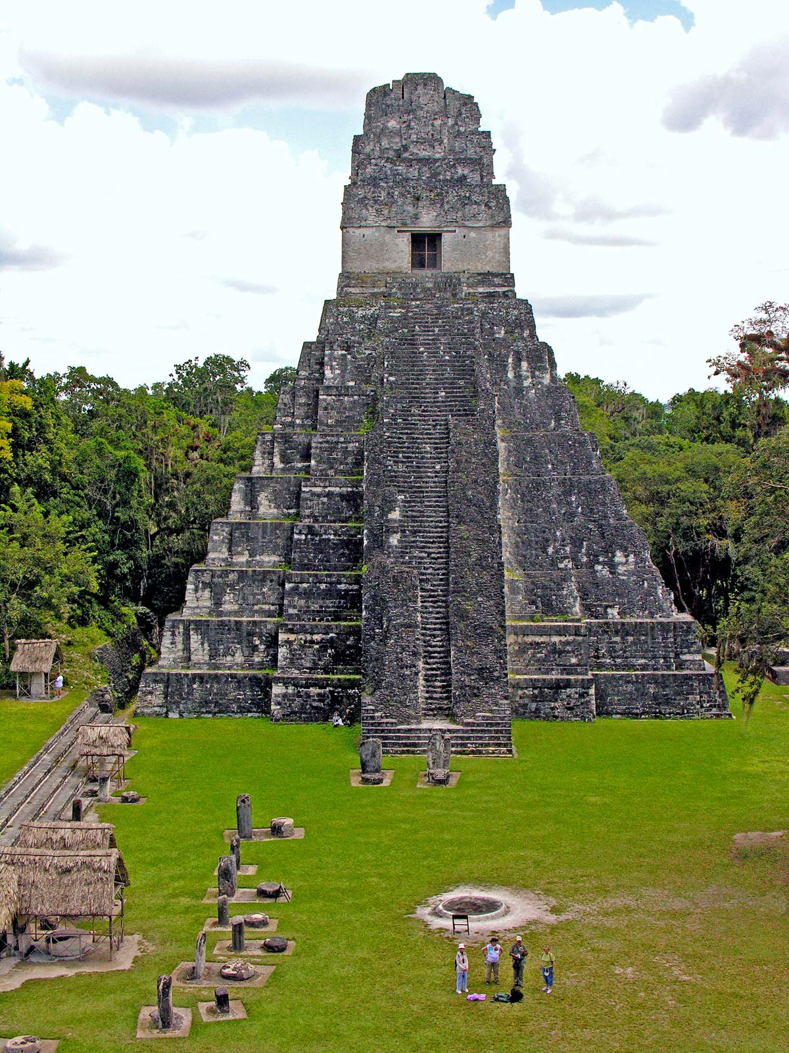
Maya Food
CLICK HERE
Maya ate simple food. Maize was essential food in there diet. Maize was used in a lot of things such as: porridge, pancakes and tortillas. Along with vegetables like: squash, beans, avocado, tomatoes.
They ate quino which was a tiny round ivory coloured whole grain. Tomatoes where a very important crop. Squash was used as stew. Coco beans were used for a chocolate drink and they were so valuable they were used as money. Tamals was a popular food; it was a pastry with a choice of your filling such as: cheese, chilli, pork/chicken. For breakfast they ate scrabbled eggs with queso balcno (white cheese). Poc chuc which was a dish of meat with salt, orange juice and vinegar. Also for breakfast they ate a side of black beans and fried plants. For dessert they ate gavai, paypa, avocado, custard or sweetsop and honey.
By Ebony and Grace

Slide 12
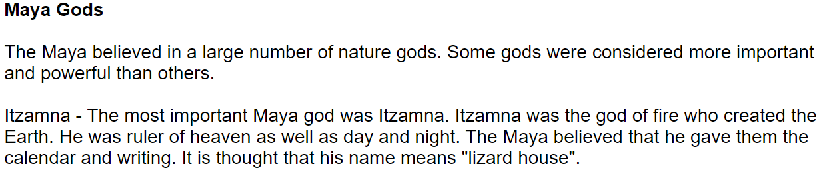
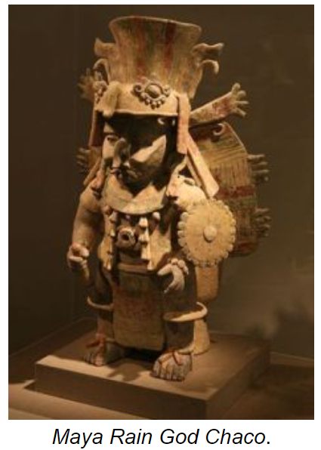
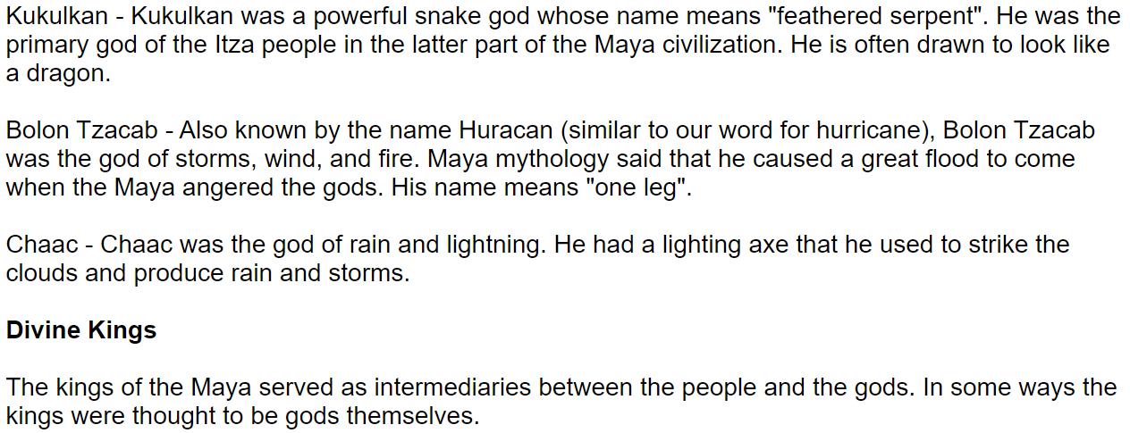
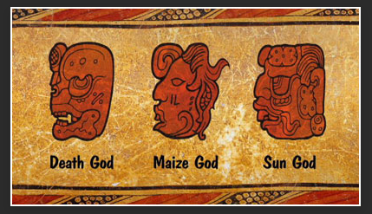

Slide 13
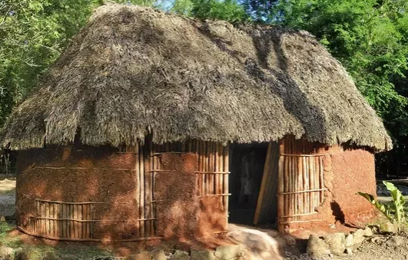
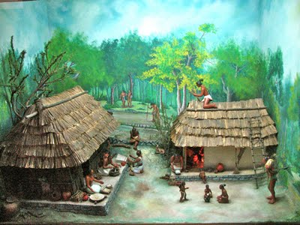
By Logan and Darcie-Rose
Mayan houses
The households were composted of different buildings. There furniture were made from carved out rock and wood. They all had there own bedrooms. There beds were made from wool and grass this made it comfortable. They had workshops and bedrooms. All houses had a : living area, kitchen area and bedrooms. Households could be quit a maze sometimes because it was so big. Homeless people slept on hammocks.

Slide 14
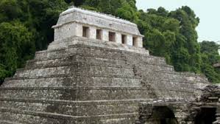
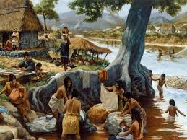
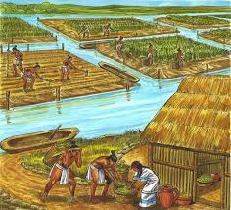
Maya jobs
Most of ancient Maya were farmers. They were very good at farming. The surplus was stored in warehouses in each city-state to be used for trade and to feed people in city-states who needed it. The women in the farms helped in the field at planting and harvest time. Maya commoners worked as a farmer. The farmers of Maya did not have metal tools or beasts of burden to help them farm.
They used simple stone tools and did the work by hand. In Maya communities near the coast, fish were caught using hook and line or nets. In land, drugs were added to streaky making the fish sleepy fish easier to catch. Turkeys were farmed for their meat and deer were hunted in the areas of forest that remained. Maya farmers also kept bees for honey. Maya farmers worked together to make sure the people had enough to eat.

Slide 15
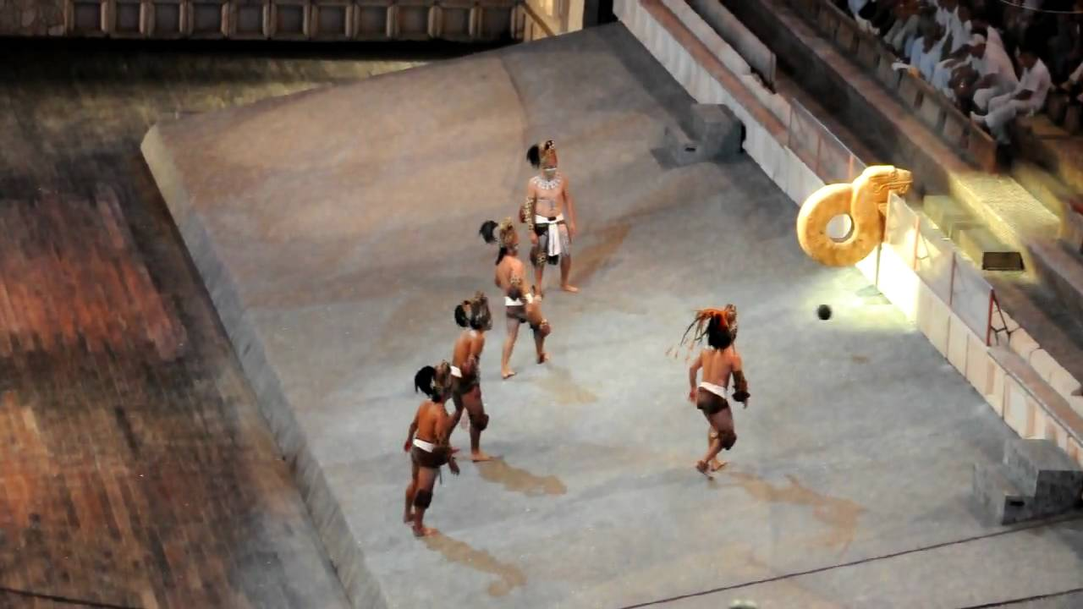
Maya POk a tok
Did you know that if your team loses the captain might be sacrificed. It was not for enjoyment it was mostly for the gods. The many reasons to keep gods happy. It was this game instead of going to war. It was played with a rugby ball. The am of the game is to get it in the hope with out your hands or your feet only your:elboys,neas and arms. You play in a stone court and usually play in front of people. There is 1 stadium in every city. The court had a hoop on the end and you had to get the ball though the hoop. Some games were played by captives.

Slide 16
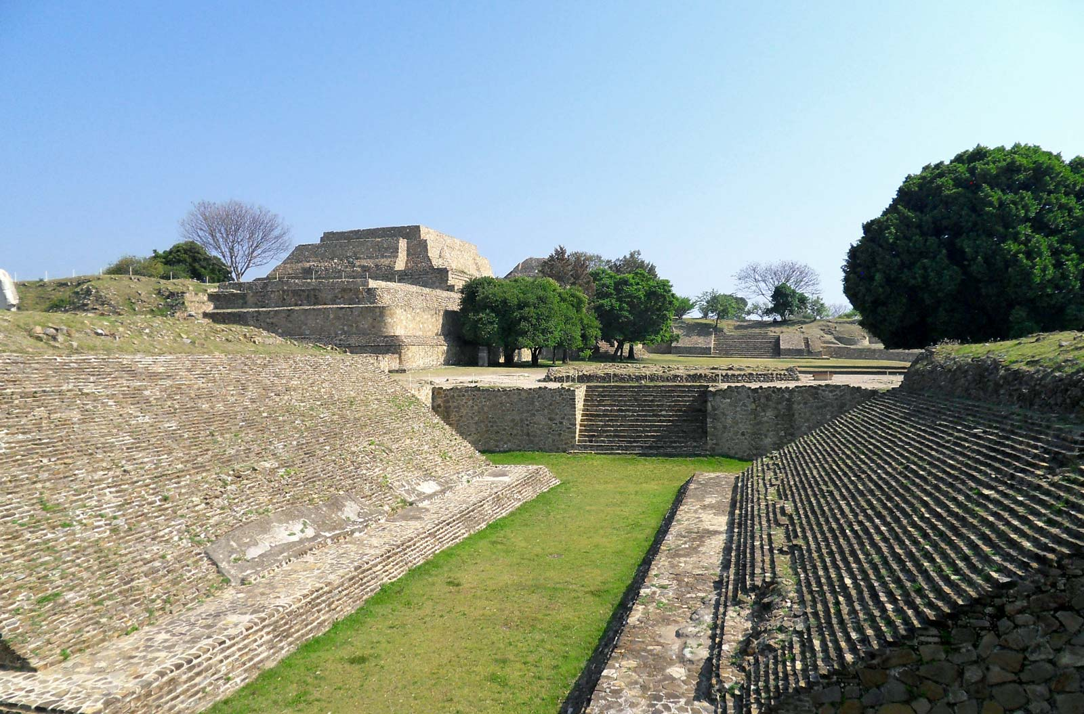
HOW TO PLAY MAYA POK A TOK
You play pok a tok with a rugby ball and you can only use: elbows, hips, knees and body. You play by getting a ball in a hop but not with feet or hands.

Slide 17
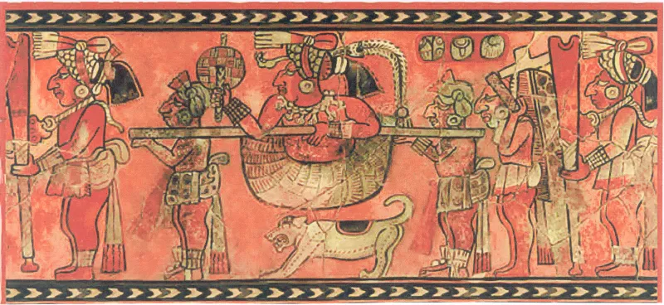
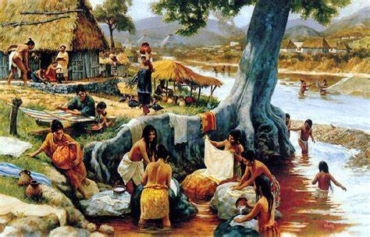
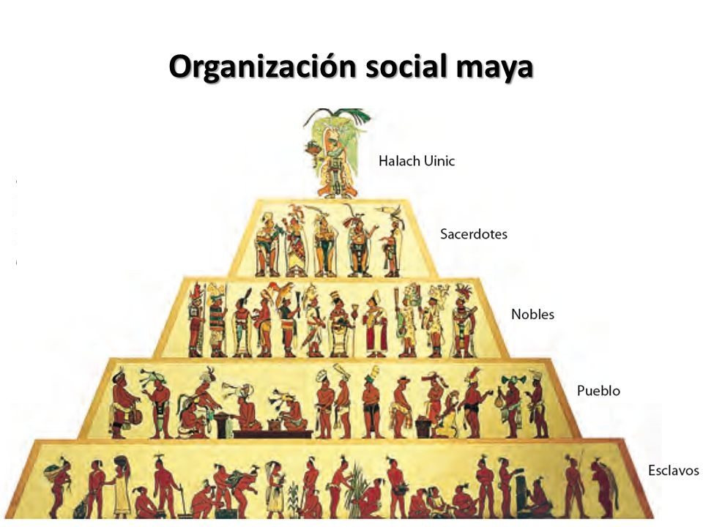
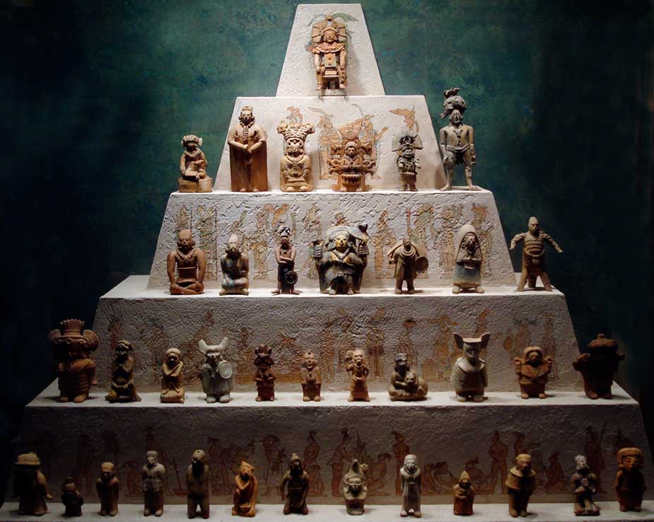
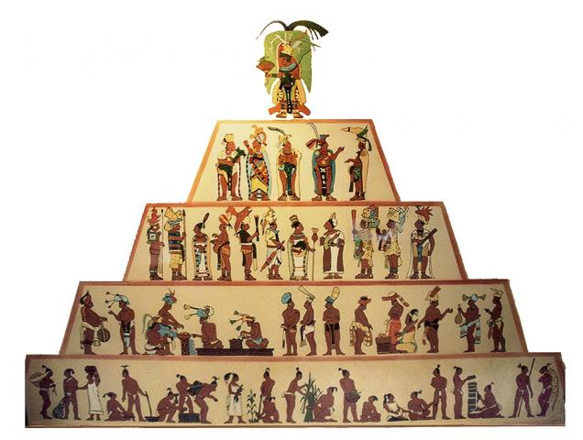
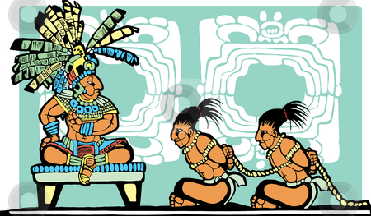
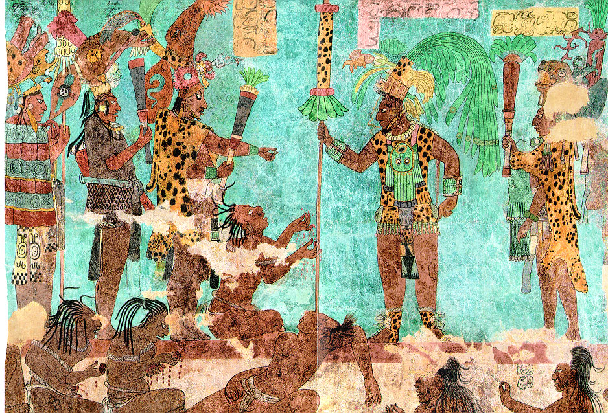
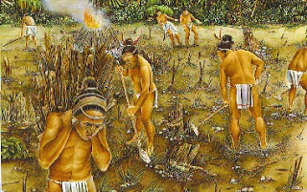
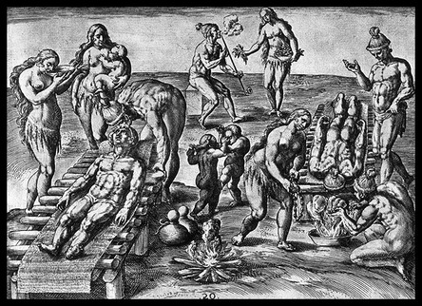
Maya slavery by Izzi and Darcey L
Slaves were the lowest level. Slaves could be orphans, or captured People, or Punished people. There only function in society was to do all of the manual labour which means that all temples were made by slaves. In addition they were also the most frequently used for human sacrifice rituals.
Did you know slaves were not
treated poorly. In general
they were way more comfortable than a
farm family. They still had no
rights or privileges.

Slide 18
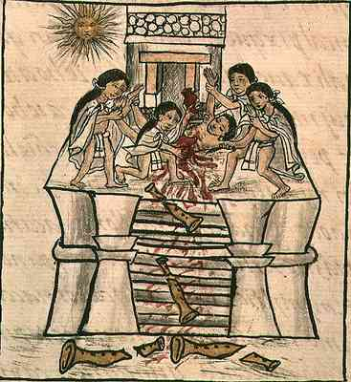
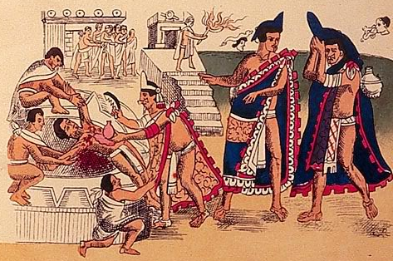
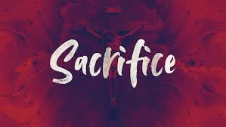
Maya sacrifices
One way human sacrifice was conducted was to throw the victim down a well. If the victim was still alive by morning, obviously the gods wanted that person to live. The Maya may have employed a sympathetic magic in their human sacrifice when they put humans down a well during a drought.
The ancient Maya used to sacrifice animals, especially goats. The selection of what and who would be sacrifice was up to the priest. Most human victims of sacrifice were slaves. At some festivals, the Maya would cut themselves so they would bleed. The Maya believed in blood sacrifice. Blood sacrifice was common. It is thought that wars were waged to provide sacrificial victims. Maya priests used: Obsidian knifes, Sting ray spines and knotted cords to draw blood from their own bodies ad offerings to a god. Maya thought their gods required human sacrifice to maintain the order of the universe. Also another way the Maya used to sacrifice was to fling people (especially slaves) off a MASSIVE pyramid. A myth of the creation reveals that a feathered serpent brought time from the underworld to humans. The feathered serpent is marked with a calendar, human sacrifice and rulership.

Slide 19
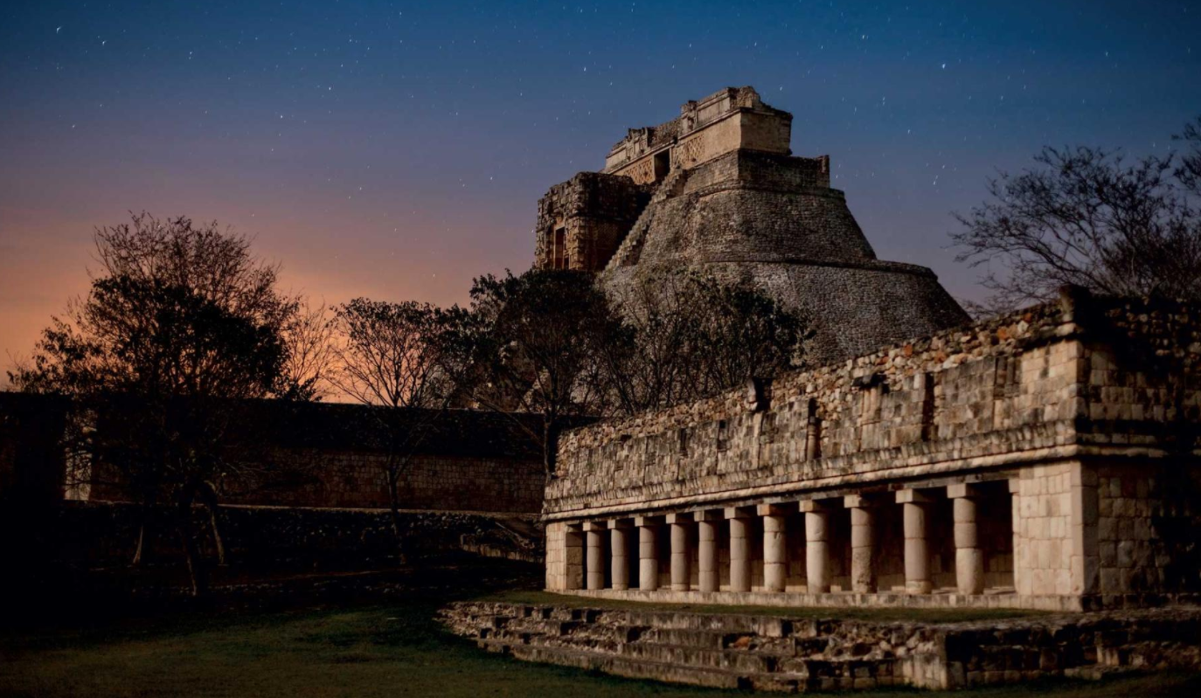
We hope you enjoyed
finding out about the
Ancient Maya!

