Slide 1

Science
Animals Including Humans
Year One
Science | Year 3 | Animals Including Humans | Mighty Muscles | Lesson 6

Slide 2
Good morning Yew Tree and Hazel Class! Go through this power point to learn more about our muscles!

Slide 3
Aim
I know why we need muscles to move.
I can set up a simple practical enquiry.
I can record my findings.
Success Criteria
I can explain how muscles allow movement.
I can identify pairs of muscles in the body.
I can set up a simple practical enquiry.
I can make modifications to a simple practical enquiry I have set up.
I can write an explanation for my findings.
I can write an explanation linking my findings with general
scientific ideas.

Slide 4

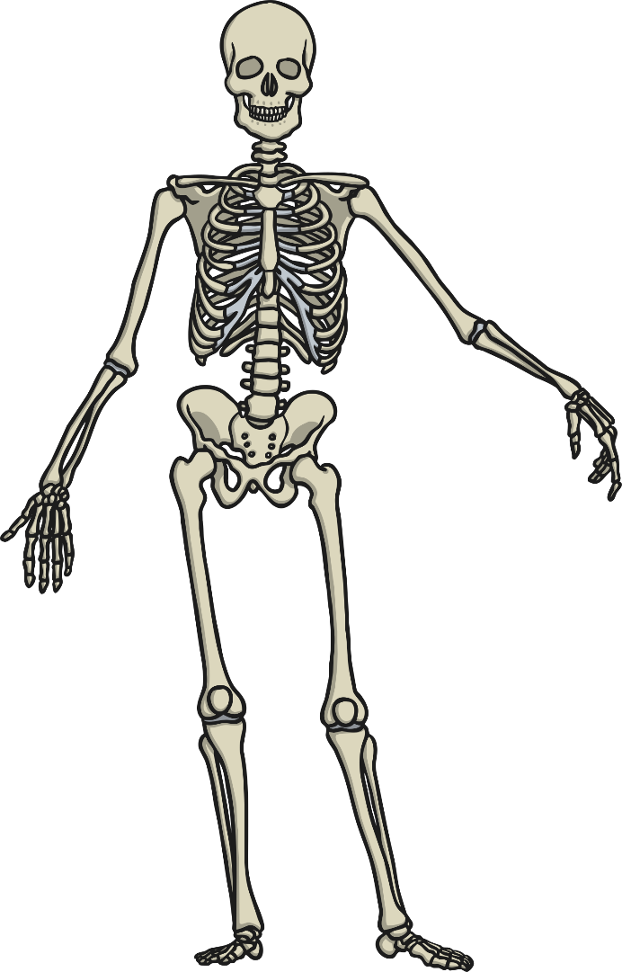
Movement
How do skeletons move the body?
Can you tell your brain to move
your leg?
A
B
Did your leg move? Why not?
Along with our bones, what else do we need to move our bodies?
C
D

Slide 5

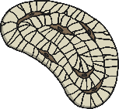
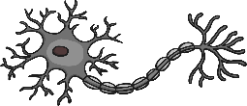
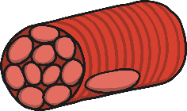
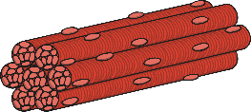
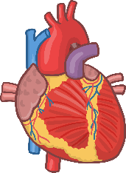
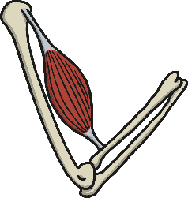
What are Muscles?
Our bodies are made up of different types of cells
smooth muscle cell
bone cell
nerve cell
Cells form to make tissue
Skeletal muscles are made up of just muscle tissue
Organs are made up of more than one type of tissue

Slide 6

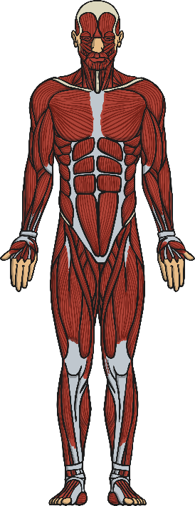
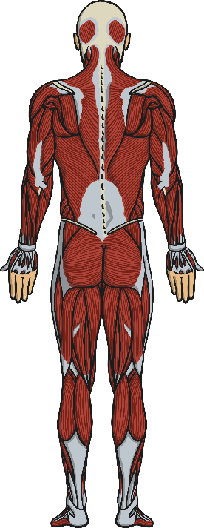
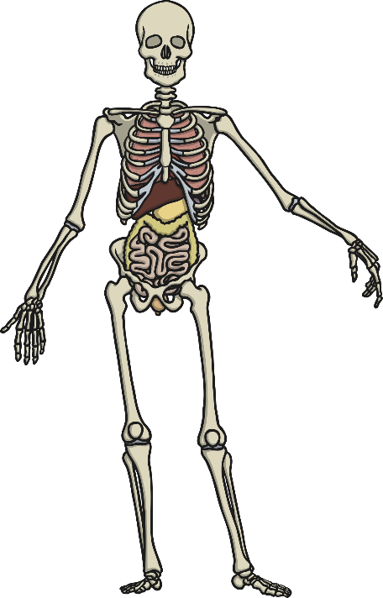
Mighty Muscles
A
C
Skeletal muscles are attached to bones and enable movement.
Some organs have muscle tissue. Which organs have muscles?
(Hint: Think which organs move things around the body.)
B
D

Slide 7
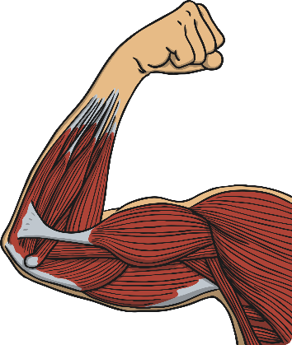

Voluntary and Involuntary
Some muscle movement is voluntary and we can control it. Other muscle movement is involuntary and we don’t have control over it.
Look at the pictures to the right: Which shows voluntary muscle movement and which shows involuntary?
Write down your answers in full sentences.

Slide 8
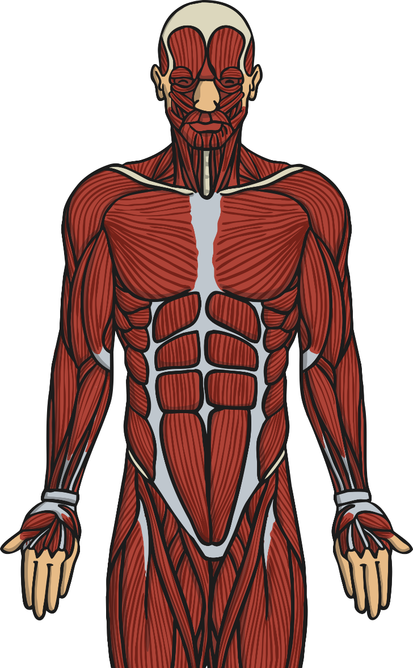
Two’s Company
Watch the following video and focus on the following:
Click me!
How do muscles move?
1
What words are used to describe the movement?
2

Slide 9

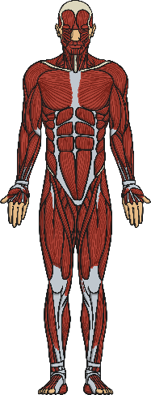
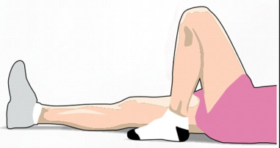
Move Your Muscles
Look at the picture below. Which muscles is she using in this activity? Circle which ones you think are being used and then try the activity yourself and see if you were right.
Activity | Prediction (before the activity): Circle or highlight the muscles you think will be used. | Results (after the activity): Circle or highlight the muscles you used.

Slide 10


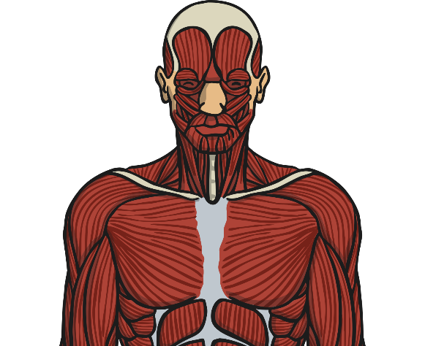
Muscle Memory
Were your predictions correct? Why? Why not?
What have you learnt in this lesson about muscles?
Remember to use the key vocabulary you have learnt in this lesson.

Slide 11
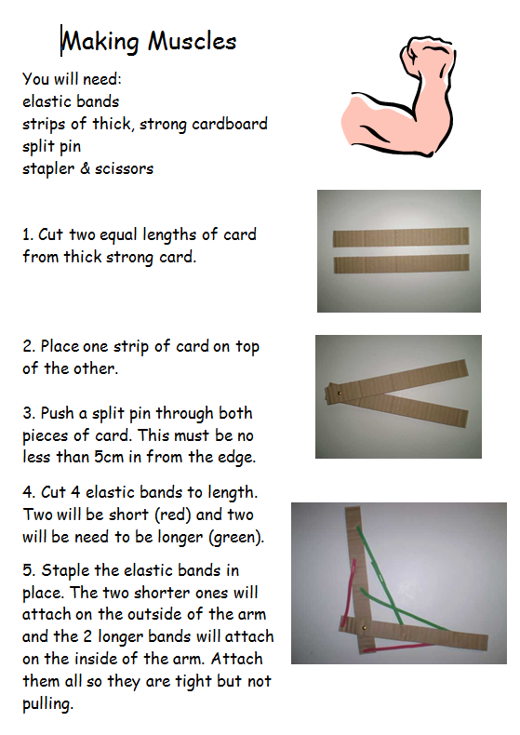
Make your own Muscle
Follow these instructions to make your own arm muscles (biceps)

