Slide 1


Reading Stars
Launching 24th September 2018

Slide 2

What do we want reading to be like at Park Gate?
We want reading to be:
  Exciting
  Fun
  Collaborative
  Interesting
  Challenging
  Interactive
  Part of your life!

Slide 3
Welcome to Reading Stars

Slide 4
So, what is Reading Stars?
A new approach to reading across the school from YrR-6.
Celebration of reading at home and school
Targets to reach for each individual
Prizes to be gained for participation and involvement
Exciting school events to join in with
Improving our ability to read

Slide 5

Rewards for being a Reading Star
The more times you read at home, the more chances you have to gain…

Slide 6
How can I get one of these badges?
Bronze = 40 reads
Silver = 100 reads
Gold = 170 reads

Slide 7
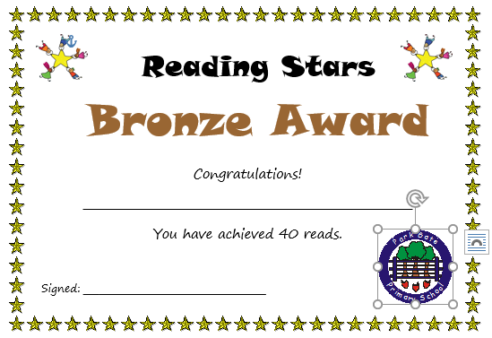
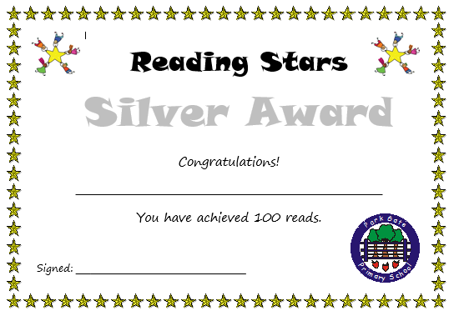
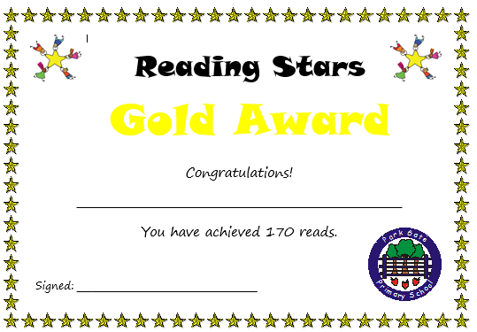
Certificates

Slide 8
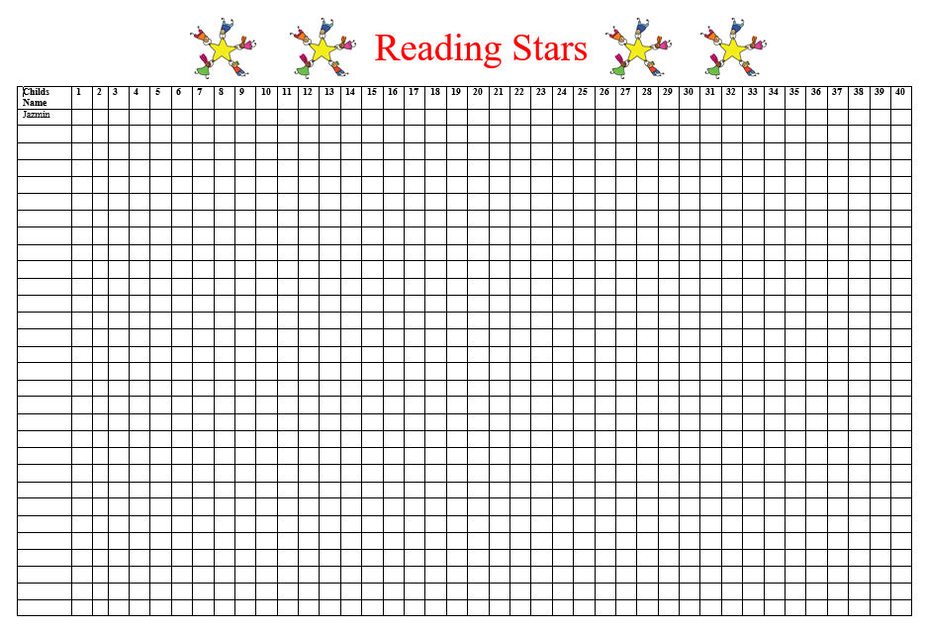
How will we track your progress?

Slide 9

What can you do in order to be a
Reading Star?
Read at least 3 times a week.
Reading EVERY day is fantastic – you will get up to 7 marks on the class chart.
Get your grown ups to write in your reading record.
Read a range of different texts.
ALWAYS have a reading book in your school bag – EVERY DAY! – Speak to an adult if you do not have one!
Share your thoughts and opinions of the books your read with your classmates.

Slide 10

What can your grown ups do in order to help you to be a Reading Star?
Listen to you read aloud
Ask you questions about your reading
Model character voices
Recommend similar texts
Take you to the local library
Read you a bedtime story
Shared quiet reading time
WRITE IN YOUR READING RECORD!

Slide 11
What can your teachers do in order to help you to be a Reading Star?
Listen to you read aloud
Ask you questions about your reading
Model character voices
Recommend similar texts
Take you to the school library
Track your reading progress
Shared quiet reading time
Share their own thoughts and opinions on texts with you
Plan exciting reading events in school
Ensure quiet reading time in class every day
Model how a reader behaves

Slide 12

Book Reviews
Whenever you finish reading a book, you will be encouraged to complete a book review.
Each book review = 1 token for the prize draw
Prize draw each term for a book token.
Book reviews to be collected in an anthology in class – used for recommendations

Slide 13
Whole school approach to promoting reading for pleasure.
Reading buddies throughout the year groups
Author visits
Book company visits
Book Week
Library reading clubs
Bring an adult to school
Designated reading time in school outside of guided reading/phonics
Assemblies with recommended authors
Whole school sponsored read/ book sales
Revamp of the school library

Slide 14


